Slide 1

Metallic/Fabric Geodesic Dome
Marshmallow Domes
Arne-Klaudia-Gergely-Jairo-Bogdan

Slide 2

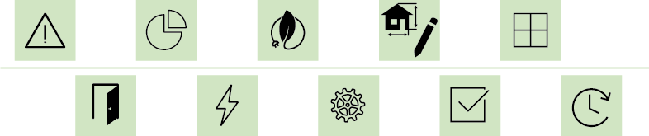

Slide 3

Problems
Structure
Door&Windows
Fabric
Assembling

Slide 4
Project Management
Time & People
Marketing
Positioning

Slide 5
Sustainability
Spare space and materials,
save energy and money
Ethics and deontology
Engineering Ethics

Slide 6
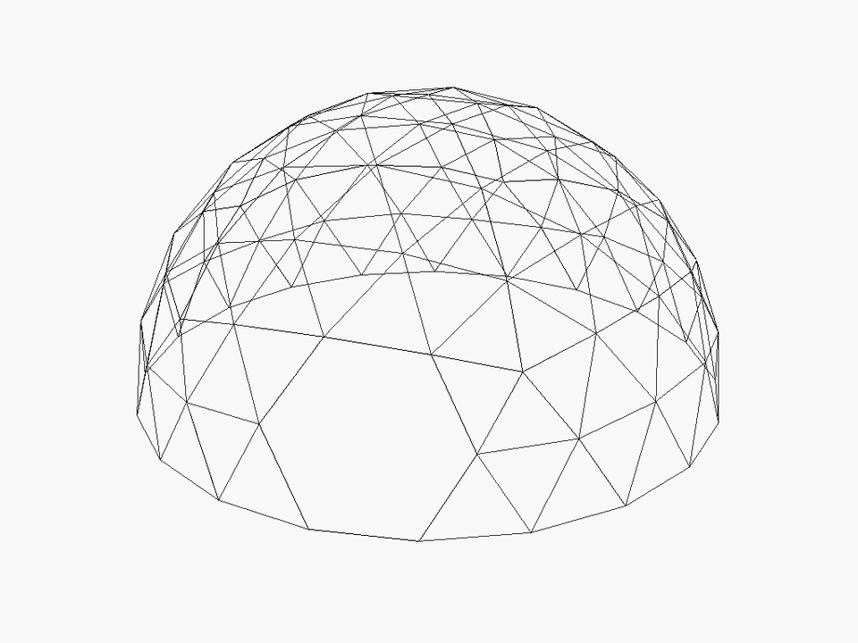
Structure

Slide 7
Structure
Strut nr | Length(mm) | Angle (°) | Quantity
1 | 861 | 7,27 | 30
2 | 1001 | 8,47 | 58
3 | 1004 | 8,49 | 30
4 | 1015 | 8,59 | 30
5 | 1064 | 9,00 | 68
6 | 1105 | 9,35 | 28

Slide 8
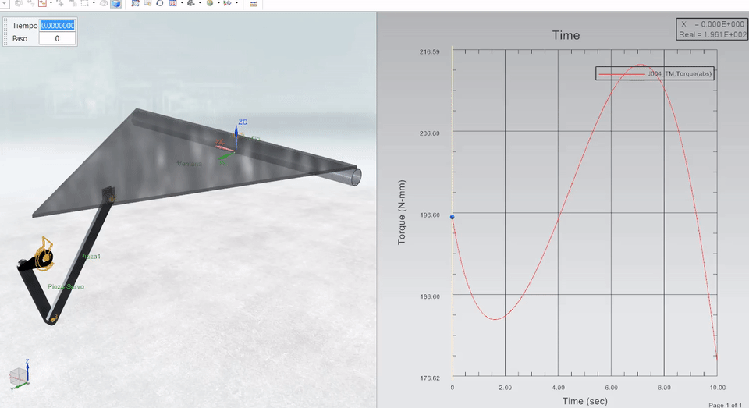
Windows

Slide 9
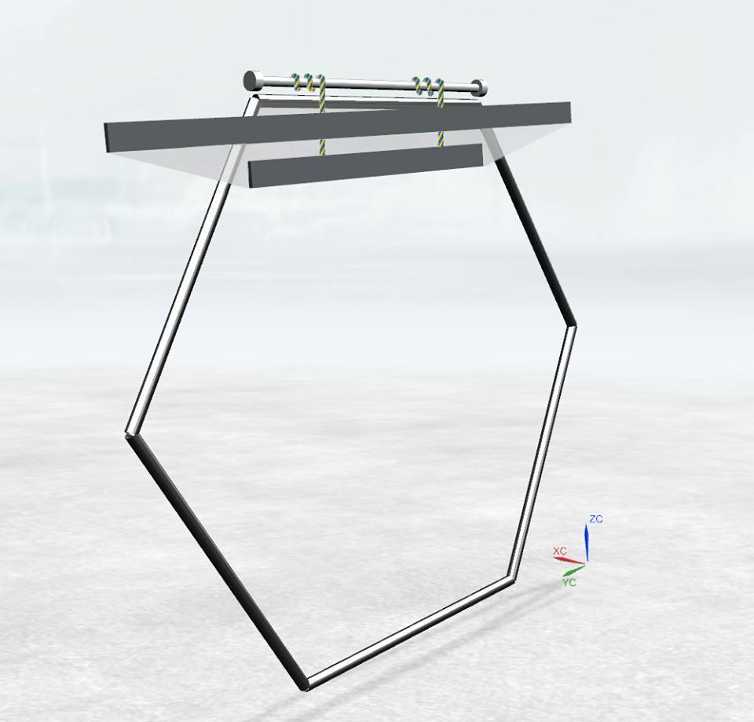
Door

Slide 10
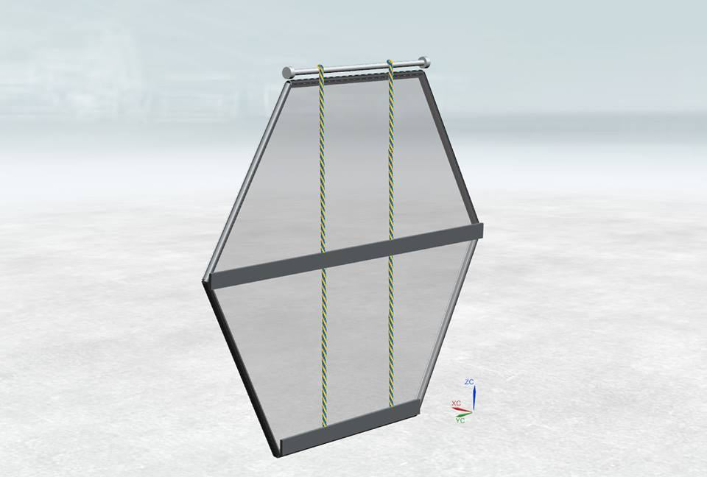
Door

Slide 11
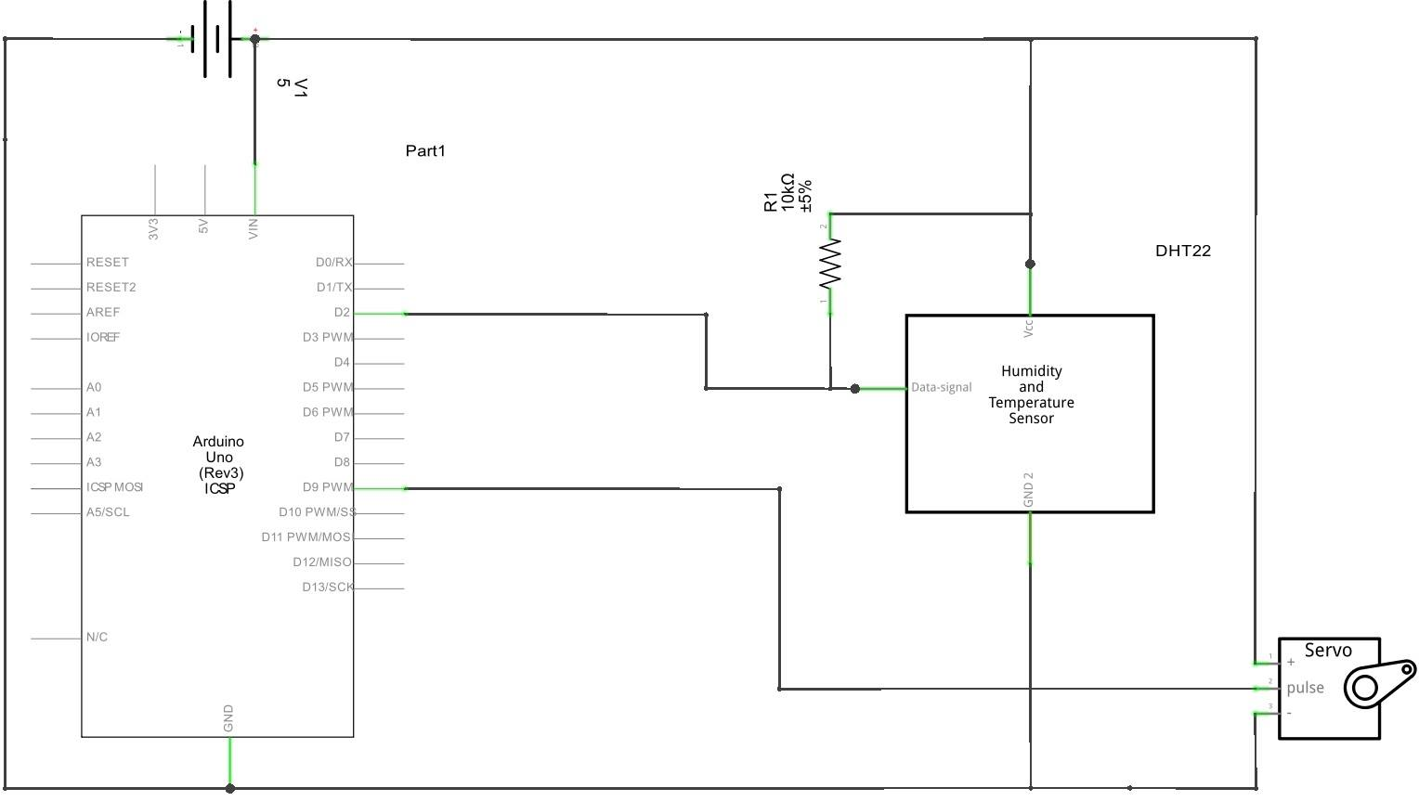
Electrical Components

Slide 12
Assembling
Strut nr | Color | Color Code
1 | Blue
2 | Yellow
3 | Red
4 | White
5 | Black
6 | Green

Slide 13

Conclusion

Slide 14
Future Development
Real scale prototype
Tests
Diameter of the struts decreased
Additional sensors

Slide 15

Video

