Slide 1

Metallic/fabric geodesic dome
Marshmallow Domes
Arne – Klaudia – Bogdan – Jairo - Gergely

Slide 2

Agenda
Problem and State of the art.
Schematics
Project management
Marketing
Eco-efficiency and Measures for Sustainability
Ethics and deontology

Slide 3

Problems and State of the Art
Designing a dome
Connections
Automatic door & windows
Heating and ventilation
Materials

Slide 4
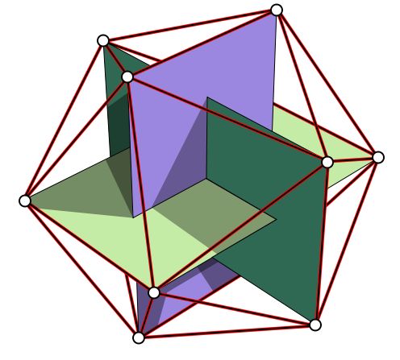
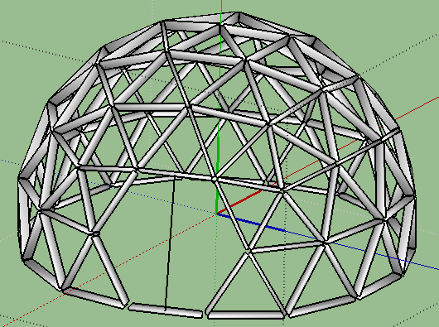
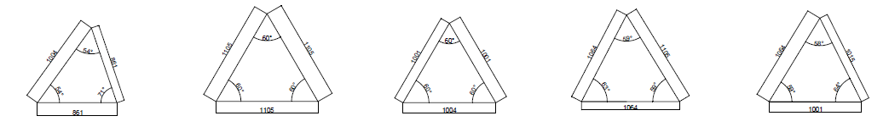
Schematics

Slide 5
Project management
Time & People
  Allocated tasks with deadlines for every team member
Cost
  How do we manage our budget
Quality
  EPS Standards, Satisfaction of people involved, Technical quality
Risk
  Identified risks and possible solutions

Slide 6
Marketing
Promotion & Budget
Segmentation
Geographic, demographic,
psychographic,
behavioral
Marketing
Plan
Positioning

Slide 7




SWOT Analysis
STRENGTHS
WEAKNESSESS
Dynamic and multidisciplinary employees.
Innovative product.
Our company is customer-oriented.
“Green” mentality implemented.
Company is a start-up.
Limited budget.
No experience.
OPPORTUNITIES
TREATHS
New technology.
There are not big competitors in our location.
Consumer-oriented society.
Leisure time: product can be easily sold.
Do-it-yourself mentality.
Permission to build our product.
Economical crisis.

Slide 8
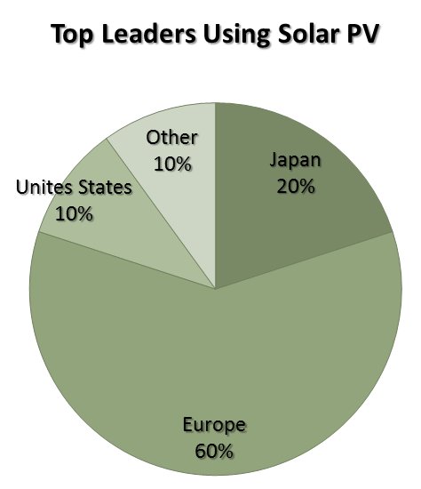

Eco-efficiency and Measures for Sustainability
Spare space and materials, save energy and money
Solar electric power

Slide 9
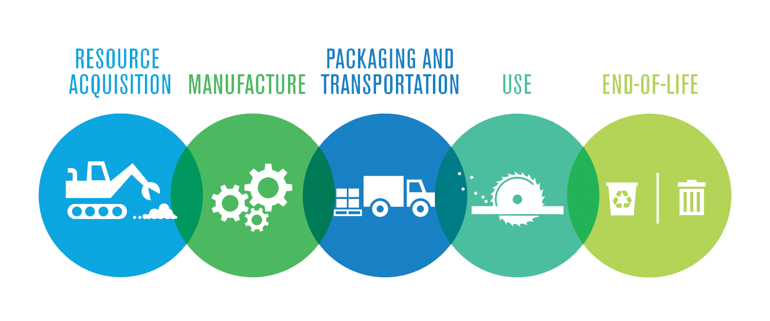
Eco-efficiency and Measures for Sustainability
Life Cycle Analysis

Slide 10


Ethics and deontology
Engineering Ethics
Academic Ethics
  Give credit to the original autor
  References
Sales and Marketing Ethics
  Truthful advertising
  Reasonable price

Slide 11


Ethics and deontology
Environmental Ethics
  Easily recycable materials
  Minimalize influence on the nature
Liability

Slide 12

THANK YOU FOR YOUR ATTENTION

