Slide 1

Metallic/fabric geodesic dome
Marshmallow Domes
Arne – Klaudia – Bogdan – Jairo - Gergely

Slide 2

Agenda
Problem
State of the art
Project management
Marketing
Eco-efficiency and Measures for Sustainability Ethics and deontology
Ethics and deontology

Slide 3
Problems
Choose between a V3 or V4 dome
Junction nodes
Automatic door
Automatic windows

Slide 4
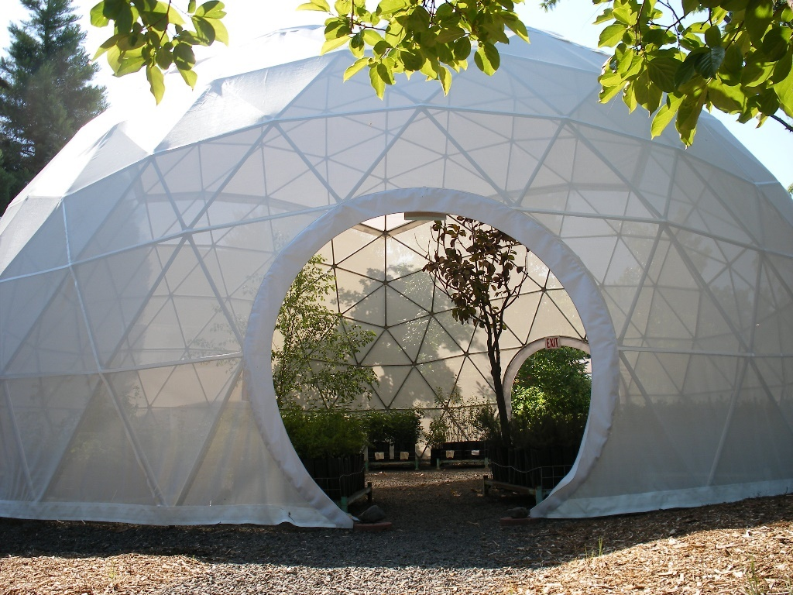
State of the art
Designing a dome
Components:
  Connections
  Ventilation/Heating
  Automatic windows/doors
Materials

Slide 5
Project management
Time & People
  Allocated tasks with deadlines for every team member
Cost
  How do we manage our budget
Risk
  Identified risk and possible solutions

Slide 6
Marketing
Who are we?
Our objectives as group,
Values,…
How do we can measure it?
Budget
Where are we?
Location analysis, competitors,…
Marketing
Plan
How are we going to get it?
Steps and costs
Where are we going?
Goals.
How are we going?
Strategies

Slide 7




Company is a start-up.
Limited budget.
No experience.
Strengths
weaknessess
Dynamic and multidisciplinary employees.
Innovative product.
Our company is customer-oriented.
“Green” mentality implemented.
SWOT
Analysis
Opportunities
Treaths
New technology.
There are not big competitors in our location.
Consumer-oriented society.
Leisure time: product can be easily sold.
Do-it-yourself mentality.
Permission to build our product.
Economical crisis.

Slide 8
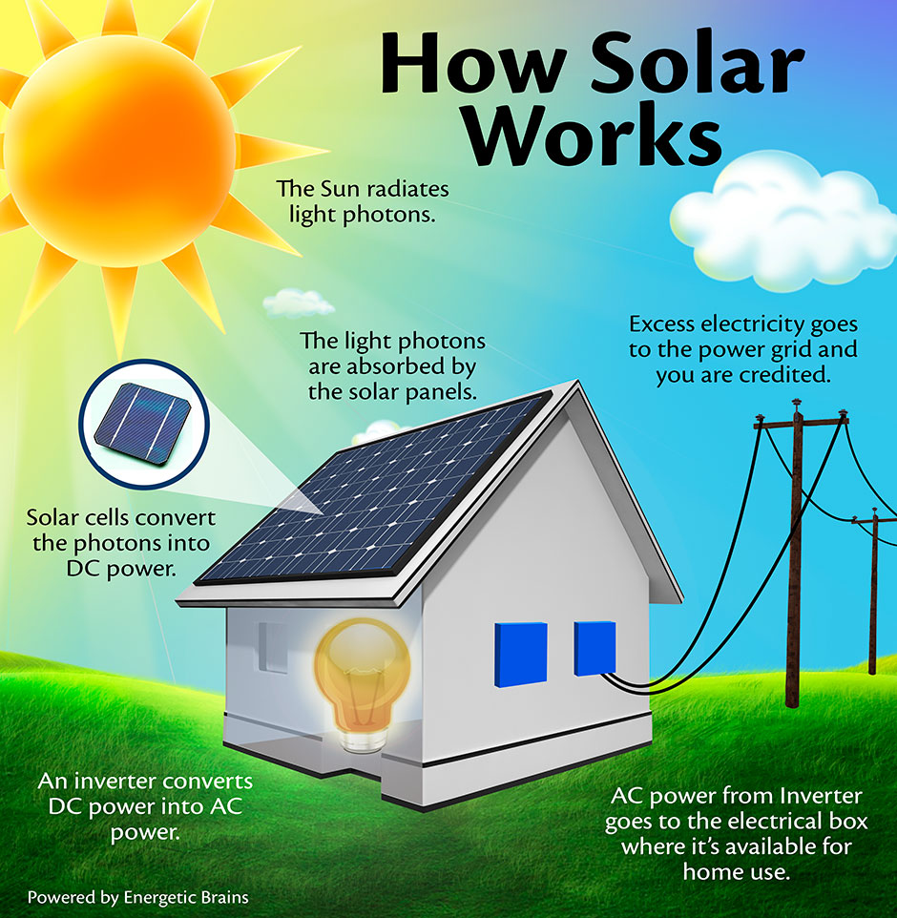
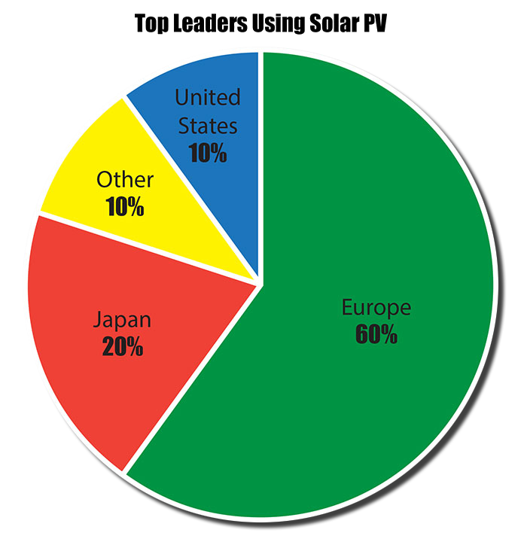
Eco-efficiency and Measures for Sustainability
Spare space and materials, save energy and money
Solar electric power

Slide 9

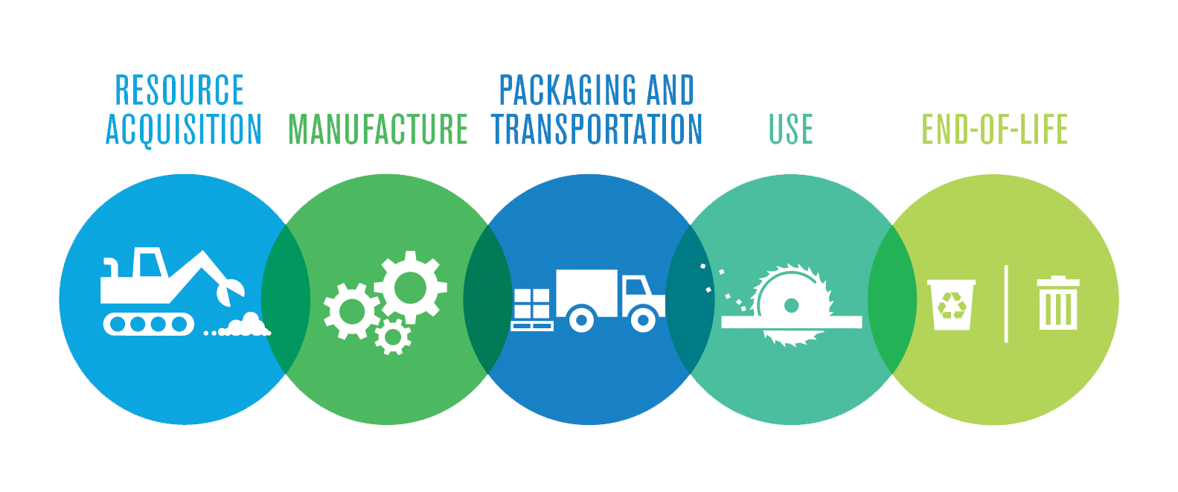
Eco-efficiency and Measures for Sustainability
Life Cycle Analysis

Slide 10


Ethics and deontology
Engineering Ethics
Academic Ethics
  Give credit to the original autor
  References
Sales and Marketing Ethics
  Truthful advertising
  Reasonable price

Slide 11

Ethics and deontology
Environmental Ethics
  Easily recycable materials
  Minimalize influence on the nature
Liability

